Slide 1
Participles
分词

Slide 2

壹
Forms and meanings (形式及意义）
贰
As predictive (作表语)
叁
As object complement (作宾语补足语)
Contents
目录
肆
As attributive (作定语)
伍
As adverbial (作状语)
陆
分词短语前加某些连词/副词/介词
柒
Absolute nominative (独立主格结构)

Slide 3

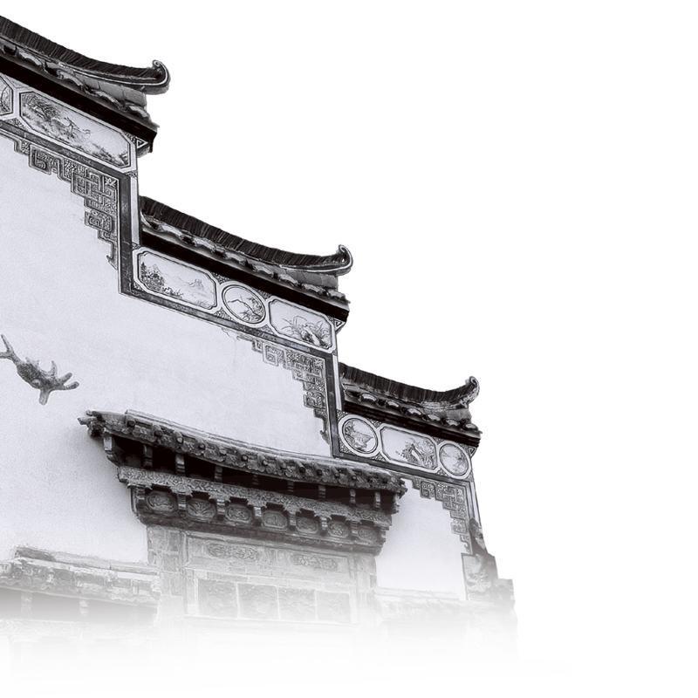
一、分词的几种形式和意义
1. Present Participle 现在分词
1）doing （现在分词的主动式）表示“主动”或“主动+进行”
2）being done （现在分词的被动式）表示“被动+进行”
3）having (been) done（现在分词的完成式）
表示分词动作发生在谓语动词之前
2. Past Participle 过去分词
done 表示“被动”或“被动+完成”
分词的否定形式：not +doing /having (been)done/done

Slide 4
分词的几种形式和意义-Examples
1. Present Participle:
1）doing （现在分词的主动式）表示“主动”或“主动、进行”
When I got home, I saw a message reading “See me at the gate.”
The police found some evidence indicating that he is the murderer.
Do you know the man talking to our class teacher?
2）being done （现在分词的被动式）表示“被动、进行”
The bridge being built will connect two islands.
3）having (been) done（现在分词的完成式）
Having past my driving test, I was able to buy my first car.
Having been turned down several times, the gift was finally accepted.
非谓语动词练习：41，42，45，55

Slide 5
分词的几种形式和意义-Examples
2. Past Participle 过去分词
done 表示“被动、完成”
The bridge built last year has connected two islands.
分词的否定形式：not +doing /having (been)done/done
Not knowing
_________ (not know) her address, he couldn’t write to her.
_______________ (not receive) a reply, he decided to make another attempt.
Not having received
非谓语动词练习：
16，27，35，41，42，45，47，50，55，57，58

Slide 6
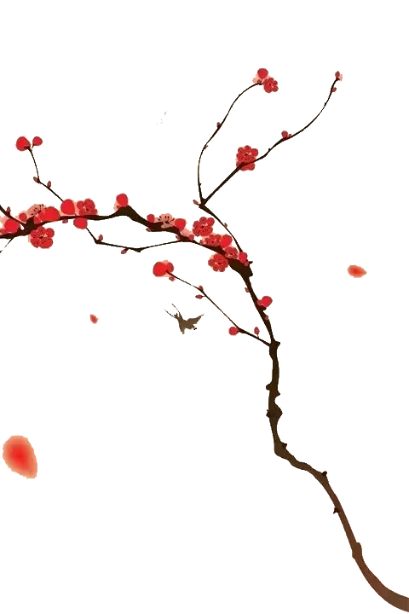
分词作句子成分
As object complement (作宾补)
As adverbial (作状语)
As predictive (作表语)
As attributive (作定语)

Slide 7
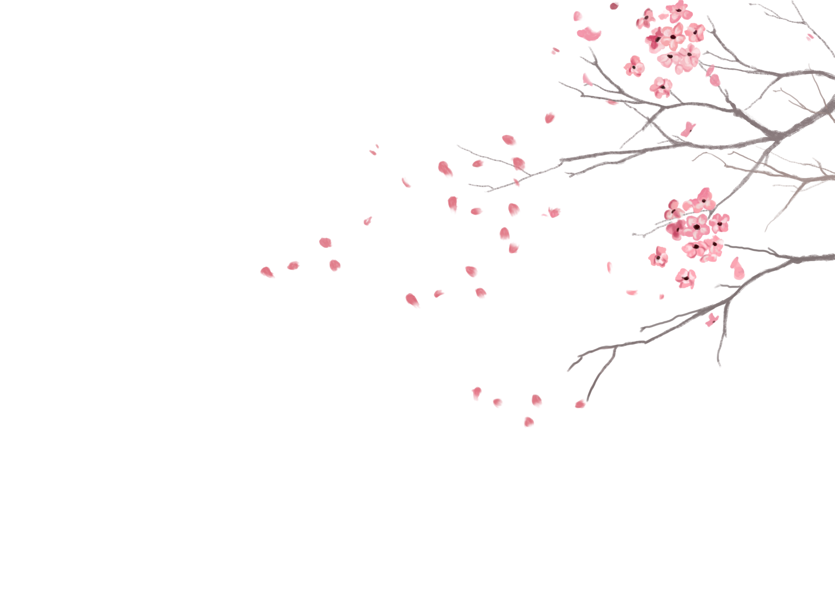
二、As predictive (分词作表语)
1. Cathy’s lessons are rather __ . (bore)
2. Her students often feel __ . (bore)
3. Please keep . (seat)
4. Cathy remains _ . (stand)
5. She looks tired with standing for a long time.
boring
bored
seated
standing

Slide 8
三、As object complement (分词作宾语补足语)
两类动词：
感官动词(see, hear, watch, notice, observe…)
使役动词(have, make, get, catch, leave…)
working
1. I found the students __________ (work) hard on their homework.
2. I’m afraid I didn’t make myself _____________ (understand).
3. I saw the boy ________________ (slap) by his father.
4. When I came back home, I found the room __________ (break) in.
5. Sorry, I can’t get the car __________ (start).
6. The policeman caught the thief __________ (steal) on the bus.
7. A computer does only what thinking people have it _______(do).
understood
(being) slapped
broken
started
stealing
do

Slide 9
四、As attributive (分词作定语)
第一种情况 分词放在被修饰的名词之前
1. That's an interesting story.
2. He asked me an embarrassing question.
3. I have often seen falling stars.
4. What have you done with the broken glass?
5. A burnt child dreads(惧怕) the fire.
Look at the ________(excite) students!
You are my _________(promise) students.
He went back home with a ____(break) heart.
exciting
promising
broken

Slide 10
As attributive (分词作定语)
第二种情况 如果是分词词组，则放在被修饰的名词之后
Do you know the man talking to our class teacher?
The bridge being built will connect two islands.
The bridge built last year has connected two islands.
teaching
1. Cathy is a young teacher ________ (teach) English.
2. Listen! The song ___________ (sing) is very popular.
Do you like the food________(cook) by your Mum
or ________(serve) in our school dining room?
being sung
cooked
served
!!!现在分词的完成式having (been) done一般不做定语

Slide 11
1. We are encouraged by his ______________(encourage) words.
2. My bedroom faces east. Every morning, I can see the ______(rise) sun if it’s fine.
3. China is a _____________(develop) country.
4. Most of the people ____________(invite) to the party were famous scientists.
5. His _________(puzzle) look shows that he doesn’t understand me.
6. Many things ____________(consider) impossible in the past are common today.
7. The bridge ________(build) decades ago needs repairing.
The bridge __________(build) will be completed soon. (分词vs.不定式)
encouraging
rising
developing
invited
puzzled
considered
built
to be built
非谓语动词练习：21，22，23，24，26，30，33，35

Slide 12
五、As adverbial (现在分词作状语)
相当于状语从句，但分词主语必须与主句的主语保持一致。
分词作状语,可表示时间、原因、结果、条件、让步或伴随等情况。
When he looked down, he saw the smashed flower pot.
Looking down, he saw the smashed flower pot.
Because he was praised by the teacher, he felt on top of the world.
Praised by the teacher, he felt on top of the world.
Looking through the essay, a few mistakes were found. (X)
Looking through the essay, I found a few mistakes. (√)

Slide 13
1. When my friend returned home, she learned that the police had been to the flats.
Returning home, she …
2. The tough guys sat down beside a young boy. They began to tease and bully him.
Sitting down beside a young boy, the tough guys …
3. Because he has a lot of work to do, he can’t go out with you.
Having a lot of work to do, he…
4. Because I was busy at that time, I didn’t check the change carefully enough.
Busy at that time, I…

Slide 14
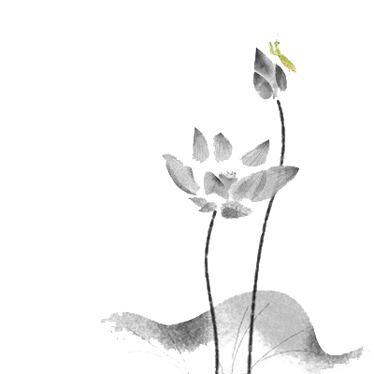
5. If you treat it gently, the fabric should last for years.
Treated gently, the fabric …
6. If I am given another chance,
I will do it much better.
Given another chance, I will…
7. When it is seen from space, the earth
looks blue.
Seen from space, the earth looks blue.
非谓语动词练习： 44，51，52，53， 56

Slide 15
分词其他考点
陆
分词短语前加某些连词/副词/介词
柒
Absolute nominative (独立主格结构)

Slide 16

六、非谓语动词前加某些连词/副词/介词
常见：when, while, if, unless, once, though, on, after…
You should be careful when crossing the street.
If given another chance, I will do it much better.
If given the same treatment, he’s sure to be better.
He will not come unless invited.
Once heard, the music is not easy to forget.
When told the news, he jumped with joy.
On hearing the news, he jumped with joy.
After eating a quick lunch, I went to the railway station to see my friend off.
非谓语动词练习：43，46，48，49，54，60

Slide 17
七、Absolute nominative (独立主格结构)
动词短语做状语，有时可以有自己的主语。语法上把带有自己逻辑主语的结构叫做独立主格结构。
时间
The problem settled, they all left the meeting room.
问题解决后，他们都离开了会议室。
Weather permitting, the football match will be held next Monday.
如果天气允许的话，足球比赛将在下周一举行。
His leg badly hurt, he had to stay in bed.
他的腿伤的很重，他不得不躺在床上。
Students sat in the classroom, their eyes fixed on the blackboard.
学生坐在教室里，盯着黑板看。
条件
原因
伴随

Slide 18
with/without引导的独立主格结构
当独立主格结构与主句逻辑关系较为紧密时，常用with/without引导。
With winter coming, trees are beginning to shed leaves.
Without anyone noticing, he slipped through the window.
With her skirt caught on a nail, she could not move.
With her eyes fixed on the portrait, my mother was deep in thought.
With the city authorities having arrived, the ceremony began.
With so many things to do, I couldn’t go out. (不定式)

Slide 19
woken
Every morning, _________(wake) up by the alarm clock, I get dressed and begin to prepare breakfast for my family.
After ________(have) a quick breakfast, I ride to the school _________I teach, rain or shine.
After a day’s hard work, I go back home, __________(feel) _______(wear) out.
What makes me happy is that the dishes _________ (cook) by my husband look ___________(invite).
Sometimes, I have to work far into the night, _________(go) over students’ homework and ______________(prepare) lessons for the next day.
having
where
feeling
worn
cooked
inviting
going
preparing

Slide 20
____ white, the house looks much better.
A. Having painted B. Painting
C. Painted D. To be painted
C
2. Watching English news on TV, _______.
A. there came a cry for help
B. a cry for help was heard
C. he came to me for help
D. I heard a cry for help
D

Slide 21
B
3. ______ by a cigarette end, the fire spread
quickly and destroyed the whole house.
A. Starting B. Started
C. To start D. To be started
C
4. While ______ for the bus, I began ____
the magazine____ from the library.
A. waiting; reading; borrowing
B. waited; reading; borrowed
C. waiting; reading; borrowed
D. waited; to read; borrowed

Slide 22
C
5. ____ there more than once, he offered
to show us around the town
A. Being B. Been
C. Having been D. To be
A
6. If ____, I’ll come to your help at once.
Don’t hesitate _______ me.
A. needed; to call
B. needing; calling
C. necessary; for calling
D. you need; to call

Slide 23
Thank you

Slide 24
分词短语做前置定语
Located at the Pudong New District, the Shanghai Disneyland will be the sixth Disneyland theme park in the world.
Planted along either bank of Huangpu River, trees and flowers added beauty to the newly-decorated bund.
Trees and flowers, planted along either bank of Huangpu River, added beauty to the newly-decorated bund.
The Shanghai Disneyland, located at the Pudong New District, will be the sixth Disneyland theme park in the world.

